Slide 1

Server
Antonio Mena, Logan Pasternak, Prayag Patel, Shreyas Ramachandran

Slide 2
Outline
Project Objective
Methodology
Explanation of code
Performance Evaluation
Project Demonstration

Slide 3
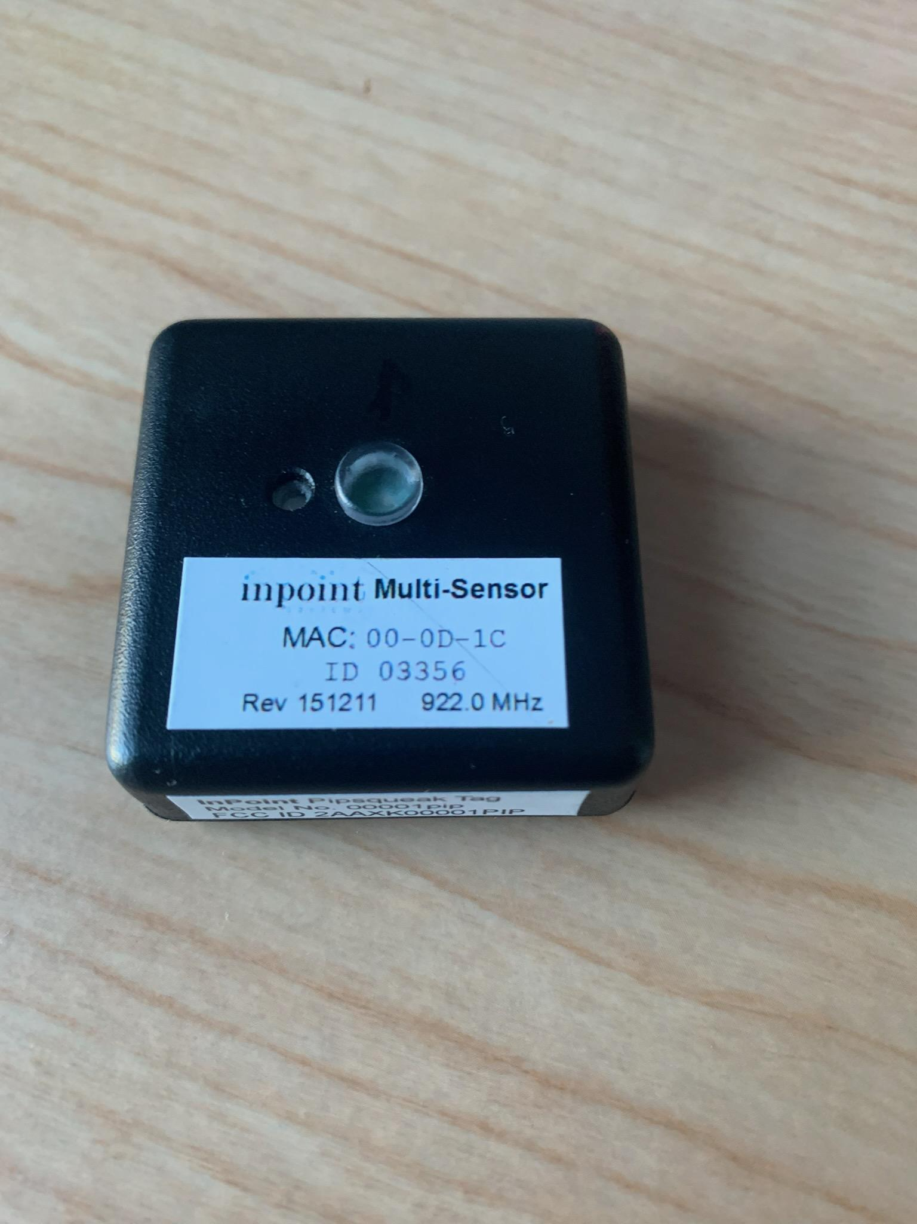
Project Objective
The goal of this project is to enable user access to real-time ambient data through a user-friendly interface
The system will collect data on light, temperature, and humidity using an RFID sensor system
This data will be displayed on a web interface for users to access
Send email notifications to user if sensor values surpass thresholds
Notes:
The primary objective of this system is to provide users with seamless access to real-time data about their surrounding environment, specifically focusing on key factors like light levels, temperature, and humidity. By utilizing an advanced RFID sensor system, the system will continuously collect these environmental data points, ensuring that the information is both accurate and up-to-date.
Once the data is gathered, it will be presented to users via a user-friendly web interface. This interface will allow users to easily monitor and track changes in the ambient conditions at any given time.
to enhance the user experience, the system is designed to be proactive. If any of the sensor values exceed predefined thresholds,whether it's a sudden spike in temperature, humidity, or light levels, the system will automatically send email notifications to users.

Slide 4

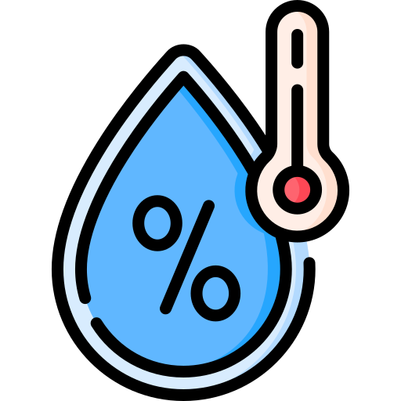

Sensor
Light Sensor: Measures light intensity using diodes and the photoelectric effect
Temperature & Humidity Sensor: Measures capacitance, resistance, and thermal conductivity of the air to determine temperature and humidity
Radio Chip: Broadcasts data over radio waves
Notes:
The light sensor measures light intensity by utilizing diodes and the photoelectric effect. When light hits the sensor, it causes electrons to be released, allowing the sensor to detect how much light is present in the environment. This data helps us understand the lighting conditions and make adjustments when necessary. Temp sensor works by measuring the capacitance, resistance, and thermal conductivity of the air. By analyzing these properties, it can accurately determine both the temperature and the humidity levels in the surrounding environment. This information is essential for monitoring air quality and comfort levels. The radio chip is responsible for broadcasting the collected data over radio waves. It allows the system to wirelessly transmit the sensor readings to a central location, such as the web interface, where users can access the data in real-time. The radio chip ensures smooth communication between the sensors and the user interface.

Slide 5
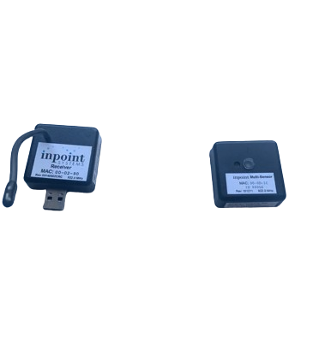
Methodology
The Pip Tag made by Inpoint Systems has a light sensor and temperature/humidity sensor.
The PipTag consists of a receiver and a transmitter:
The receiver requests the transmitter to send a signal with all the sensor values
The computer reads the response sent to the transmitter and parses it
https://github.com/mingmingP/PIPtagCode
A Linux operating system is required because of libusb
Libusb allows the computer to talk with the receiver

Slide 6



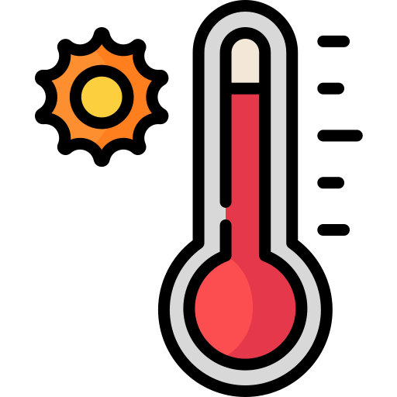
Approach (Setup)
The codebase runs on a Linux virtual machine
Using javascript we execute a command
The receiver detects sensor readings from the transceiver using a C script
Readings are sent to a localhost using socket.io to update the information as it comes to the receiver
If the values of any sensors pass a predefined threshold, an email is sent to a user using nodemailer

Slide 7
Approach (VirtualBox)
1
2
3
4
5
6
Create Virtual Machine
Configure USB
Download Repository
Download Libraries
Compile code
Run on Node.js
Ours was done on Virtual Box and a clean install on a laptop
Add USB drivers to allow the machine to read from the Receiver
We got a majority of the code from Professor Chen
C Libraries: g++, libusb
Js Libraries: nodemailer, http, socket.io, express
Compile ReceiverCode using g++
Run server script using Node.js and view data on localhost

Slide 8
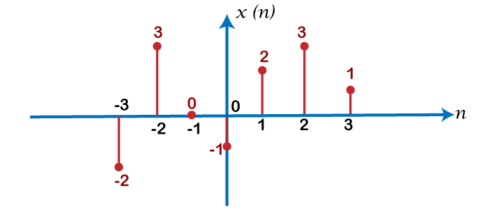
Approach (Data Handling)
Data parsed from bash script
Measurement thresholds set for humidity, temperature, and light measurements
Signal Processing
Server initializes buffer of size five for each measurement
Server serves the mean filtered results from measurements
Measurement Thresholding
Three counters initialized which represent the number of times a certain measurement threshold was surpassed.
Once counters surpass a certain threshold, an email is sent to the client’s email address

Slide 9

Approach(Email Handling)
The sending of emails was facilitated through the use of the nodemailer package.
Configuring gmail account to send emails
Create a gmail account
Set up two-factor authentication for your account
Create an app password
Create an environment file in your local directory (.env)
SENDER_EMAIL, RECIPIENT_EMAIL, APP_PASSWORD
Create and run nodemailer transport protocol

Slide 10
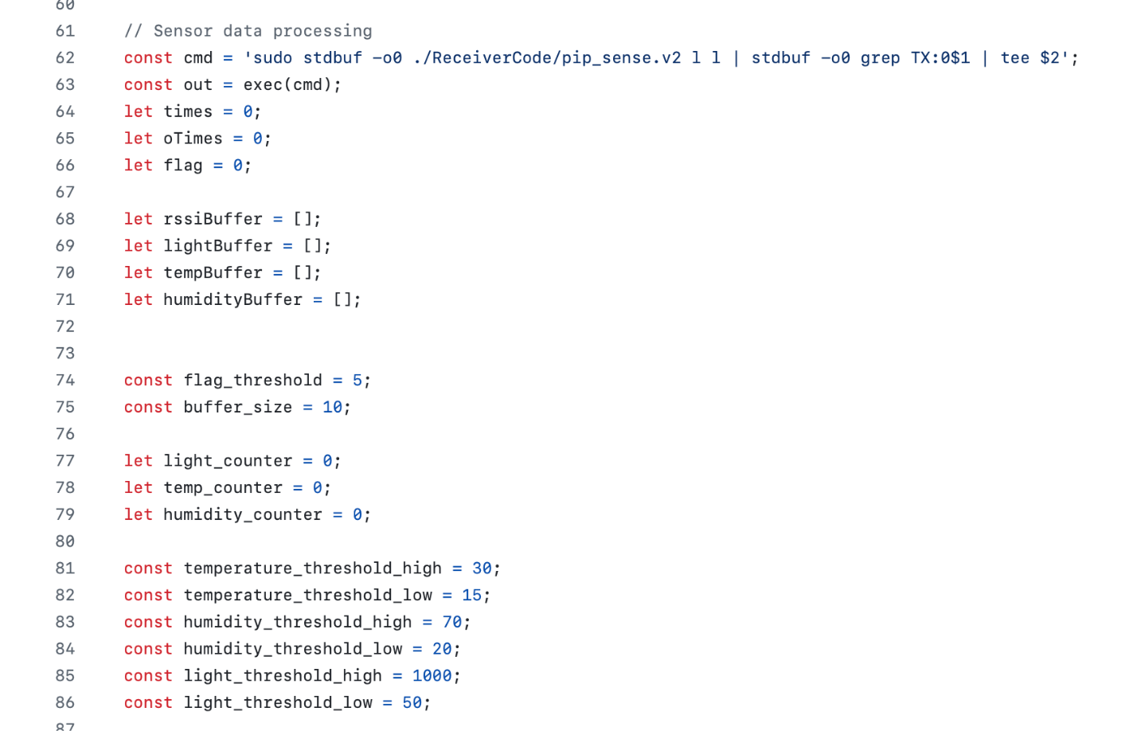
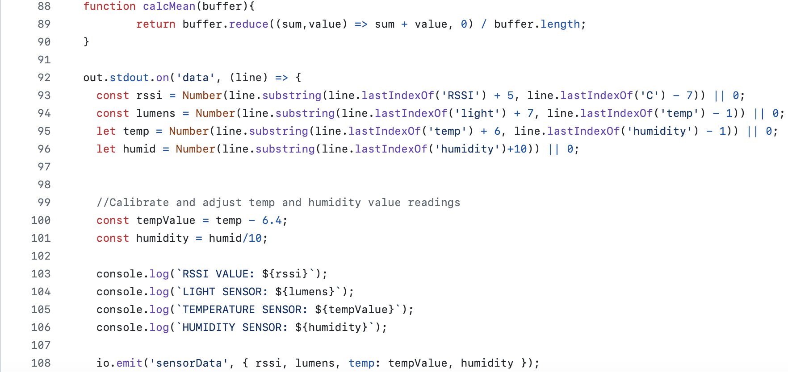
Explanation of Code
Executes command and defines thresholds
Extracts specific data values from the command output and converts them to numbers.

Slide 11
Performance Evaluation
The RFID Server is working properly, providing an accurate and real-time data collection and updates
Most of our changes involved fixing issues with C scripts and adding JavaScripts(JS) scripts to parse the command output and calibrate the data

Slide 12
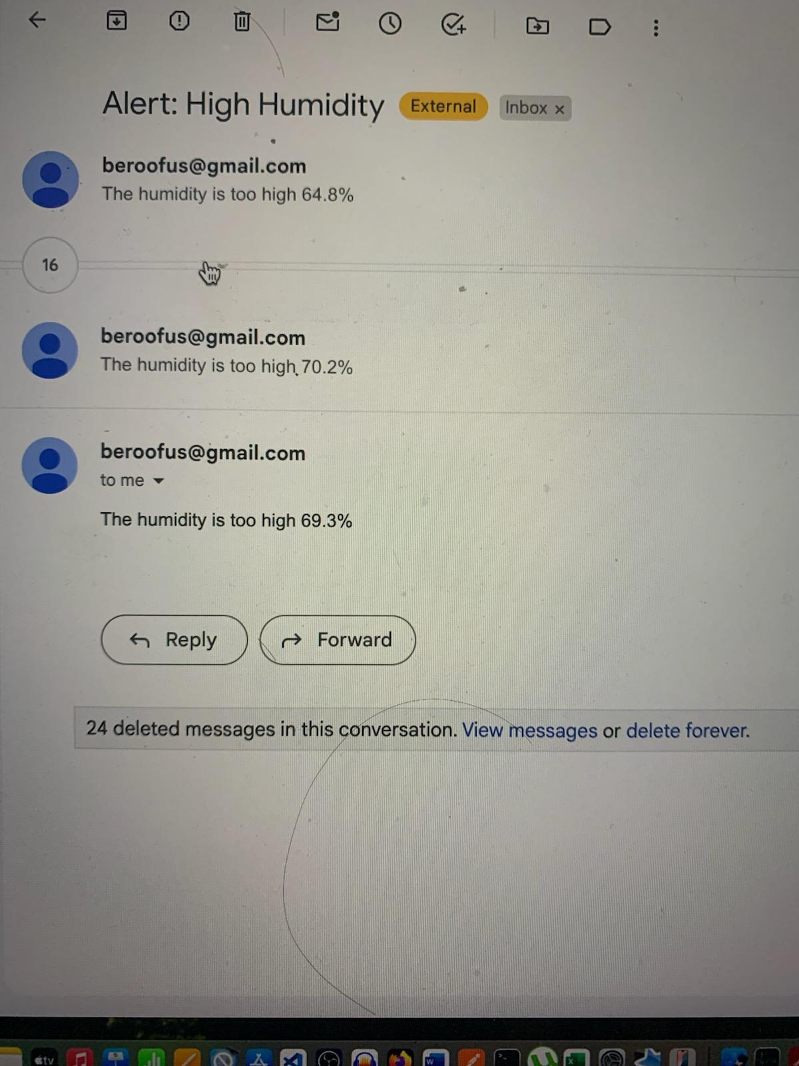
Project Demonstration

Slide 13
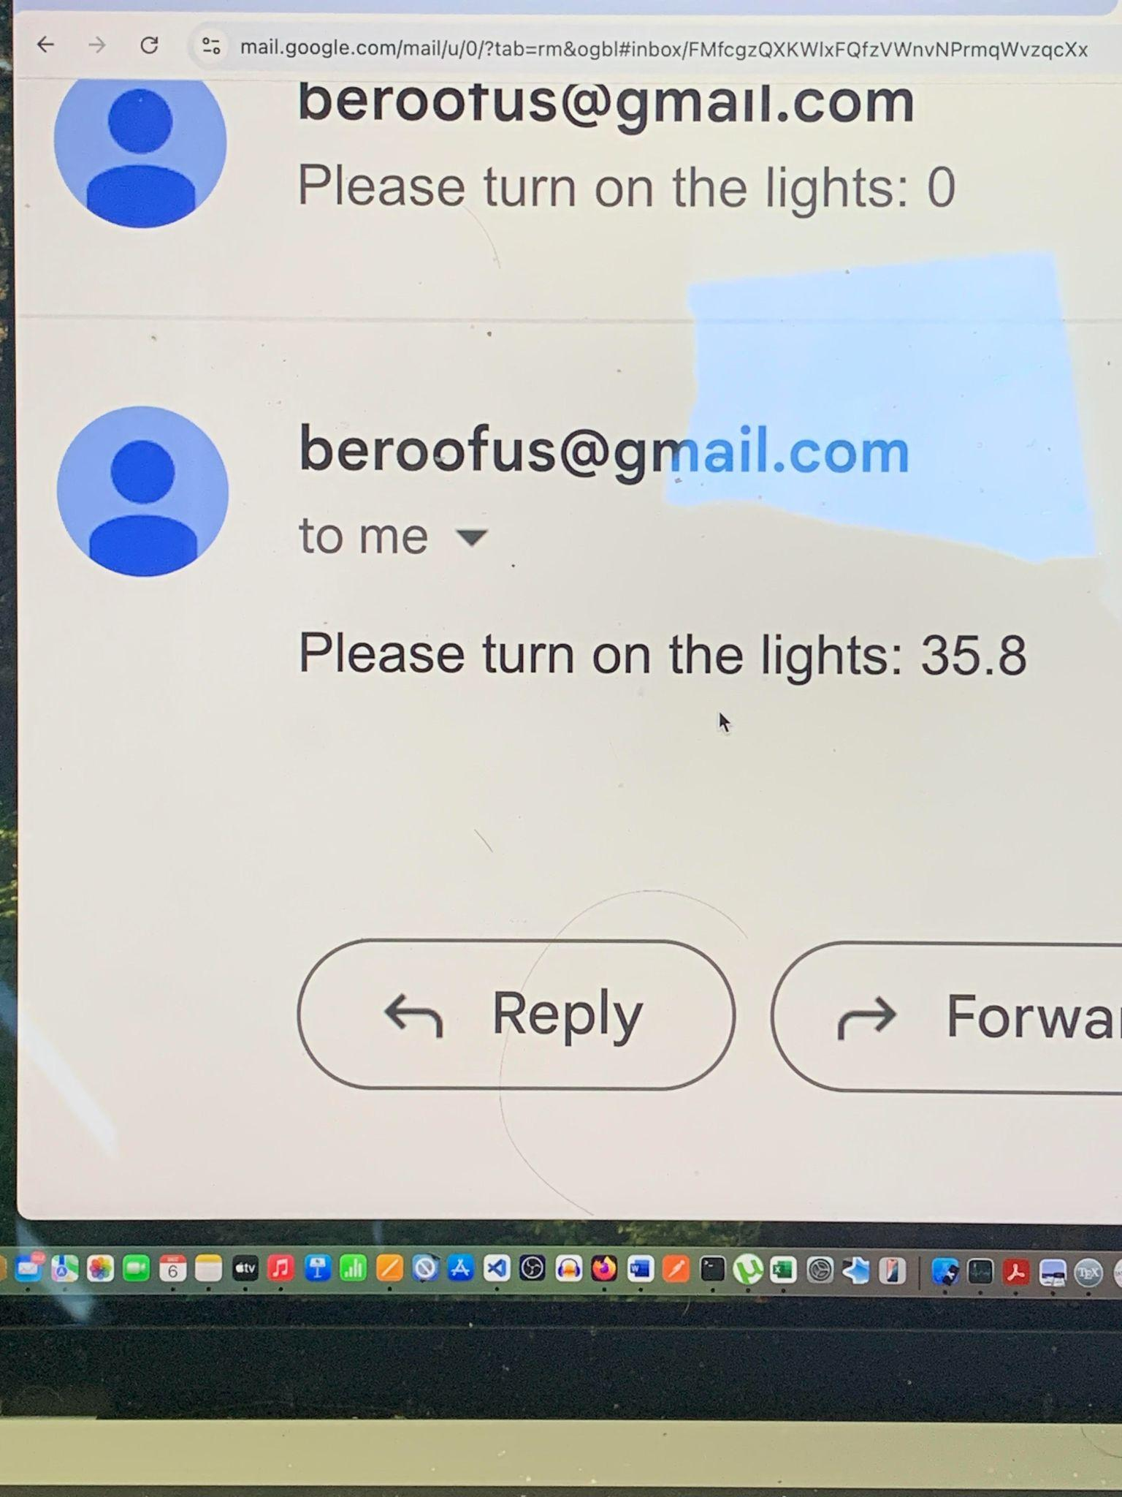
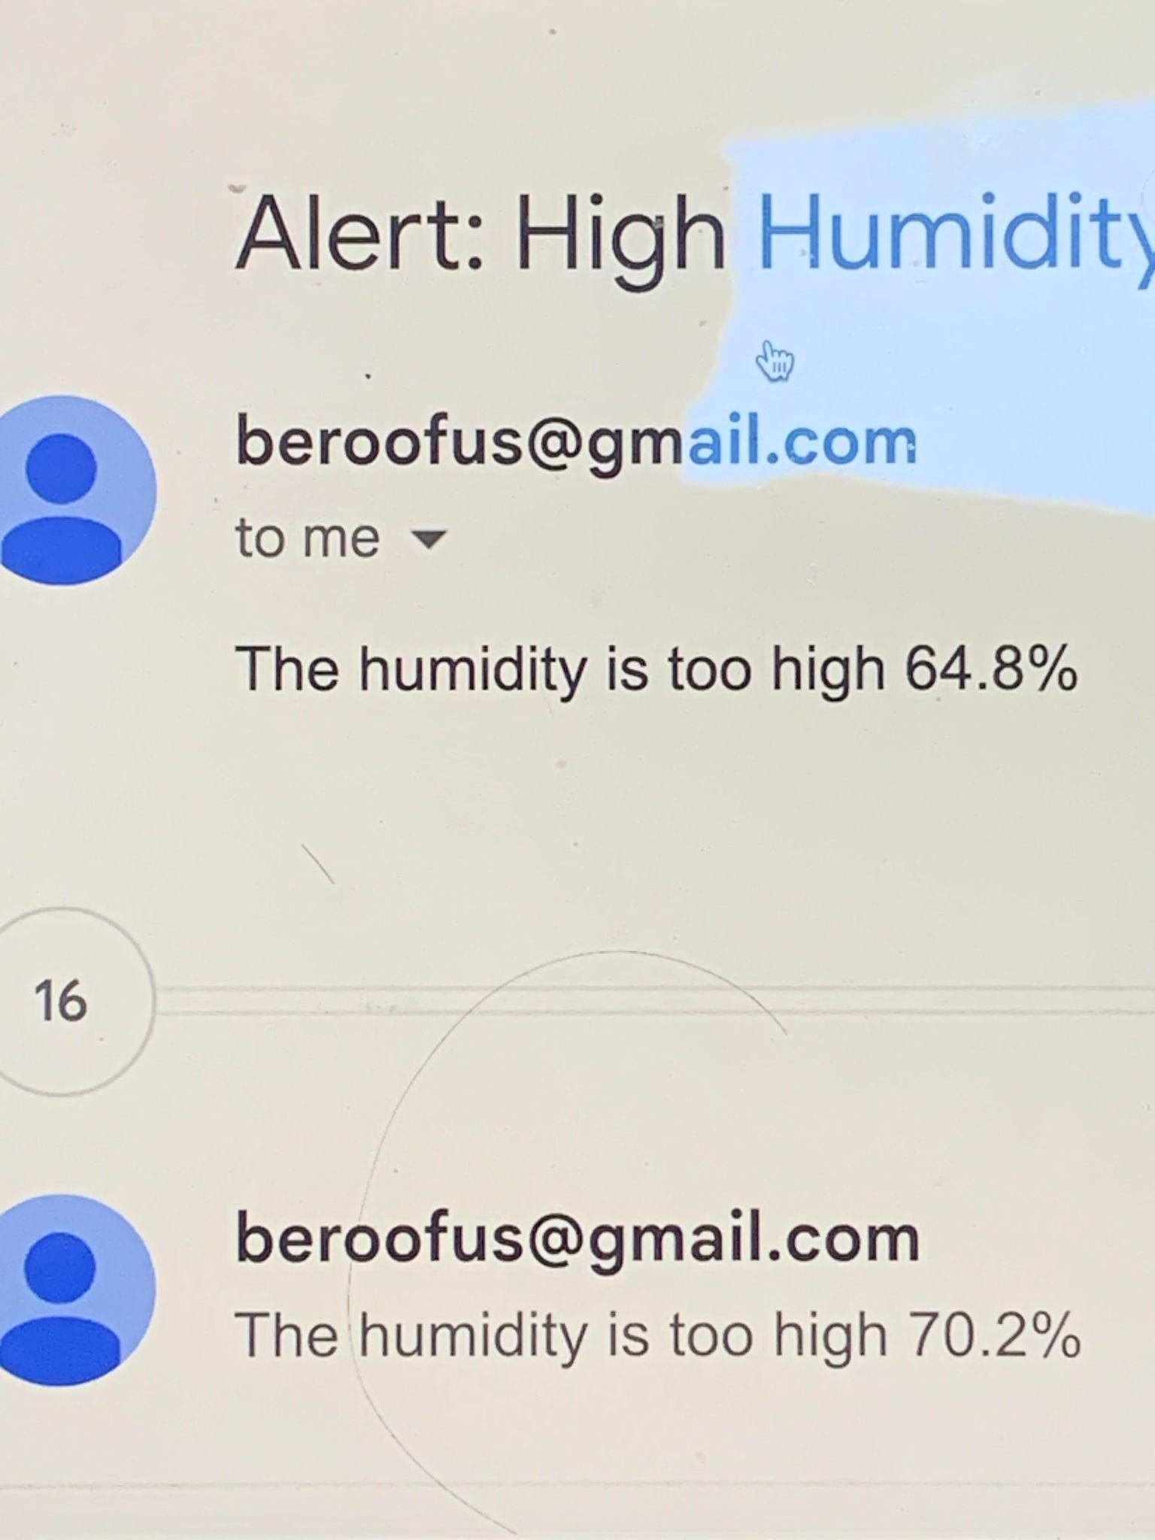
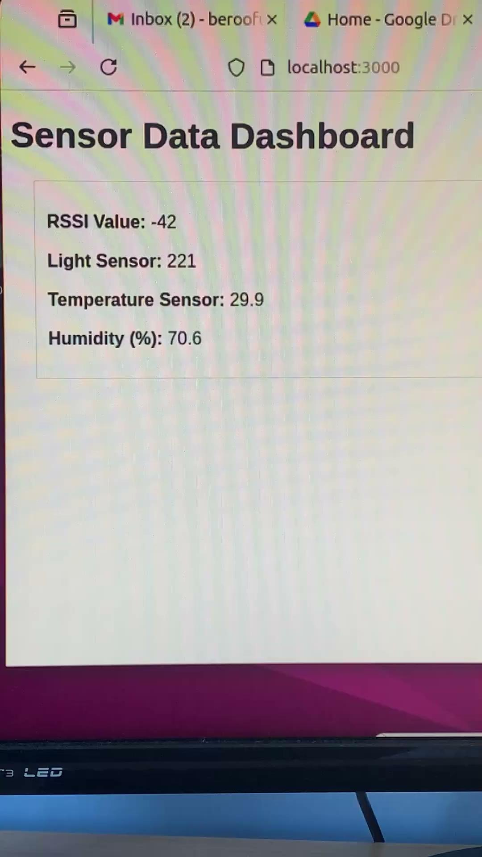
Project Demonstration

Slide 14
Conclusion
In summary, our team’s RFID server is able serve mean-filtered temperature, humidity, and lumen data from our Pip Tag to a local host. Additional, it can send email notifications to clients given measurement thresholds are surpassed a given number of times. RFIDs, although simple, are powerful tools that allows easy communication between sensors and computers
Future Work:
Data collection set up with an S2 Bucket
Incorporate classification model to add features to email services
Predicted temperature, type of clothing, etc

Slide 15
Future Work - Classification
Our classification algorithm depends on the task: Recommend clothing - Decision Tree
Classify patterns such as light signals(Morse Code) - Matrix Profile or DTW
Forecast weather - Regression methods

Slide 16
Contributions
Logan Pasternak: Email Notification Setup, Measurement Filtering
Antonio Mena: Setting up the pipsense code and verifying how it works.
Prayag Patel: Identified reasons why Linux was necessary, changed out battery, worked on JS script to send data to localhost
Shreyas Ramachandran: RFID pip tag/receiver hardware functioning, testing

Slide 17
Q&A

Slide 18
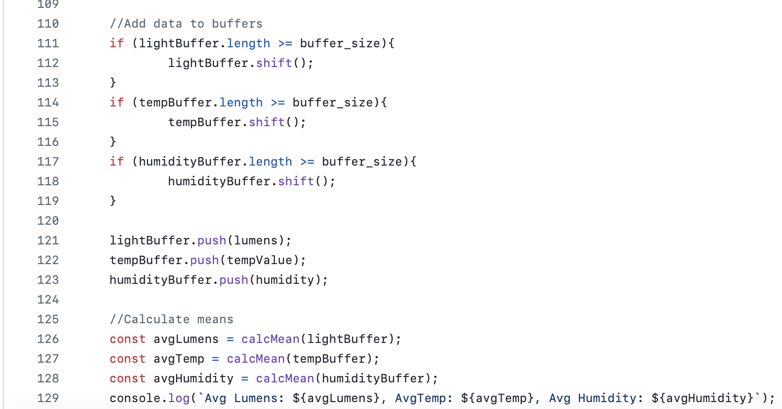
Why do the values fluctuate so much?
The values are added together and averaged. Most likely, the values fluctuate because of our code. When the values are added and averaged in real-time, there can be fluctuations.
Note: Although sensors stray out of calibration overtime, the sampling rate does not change.

